Slide 1
TIC - TAC - TOE
D6AD - Group 6

Slide 2
Content -
Introduction.
Rules of the game.
How AI would be implemented.
Preview of the Game Interface.
Coding Platform.
Team info.

Slide 3
Introduction of the topic :
Everyone is already familiar to the classic Tic-Tac-Toe.
The game is very popular among all the age groups around the world.
It is fairly simple by itself but the real fun begins when we exceed the bounds of the 3x3 Tic-Tac-Toe.
Our Project is an upscaled version of the classic 3x3 Tic-Tac-Toe and supports upto 5x5 grid Tic-Tac-Toe.
The gameplay design is so simple that user won’t find it difficult to use and understand.

Slide 4
RULES :
User is provided to choose the size {any between 3x3 to 5x5}. Difficulty of AI (1-6) can be set accordingly (only for 3x3).
The "X" player always goes first and both the players would fill the empty spaces alternatively.
The first player to get 3 of their marks in a row [in 3x3 & 4x4] and 4 [in 5x5] is the winner. (vertically, horizontally or diagonally)

Slide 5
How it works:
We use a ‘n x n’ array for the board and scan the board at every step for terminating conditions.
The human move is scanned by using the mousePressed() function and the AI move is determined by the Minimax Algorithm.
The game is run using nested for loops until one of the 3 “End Game Conditions” occur:
Human wins.
AI wins.
Draw.

Slide 6
Implementation of Algorithm:
Backtracking algorithm for the Computer.
Computer will recursively scan the board (row by row) and look for the win condition. If found, Algorithm will negate the win condition by blocking the row.
In case of no win condition, instead of randomly inserting Os at empty spaces, the AI will play based on the Minimax Algorithm to determine the optimum move (Minimax algorithm explained in the next section).
Here, since the Computer plays the first move, it will be initialized as the maximizer.
Notes:
Backtracking is a technique for solving problems recursively by trying to build a solution one piece at a time, removing those solutions that fail to satisfy the constraints of the problem at any point of time.

Slide 7
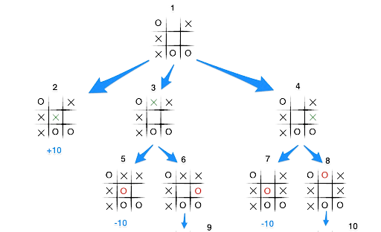
Minimax Algorithm:
Here, X is the maximizer and O is the minimizer.

Slide 8
It is used to determine the best move possible. To understand the algorithm, let’s determine a “score” for a game state at any interval of time. On winning : score = +10. On losing : score = -10. For draw : score = 0.
In Minimax the two players are called maximizer and minimizer. The maximizer tries to get the highest score possible while the minimizer tries to do the opposite and get the lowest score possible for the opponent.
Here is how the algorithm will look : a. Create a scores list. b. For each state of the game, add the minimax result of that state to the scores list. c. If it's maximizer's turn, return the maximum score
from the scores list and vice versa. d. Repeat the steps until the game is over.

Slide 9
Coding Platform:
Backend : JAVASCRIPT.
Frontend : HTML, WIX, JAVASCRIPT.
followed by preview of
THE GAME INTERFACE.
Notes:
Flask is a web framework of python.

Slide 10

HOME PAGE

Slide 11
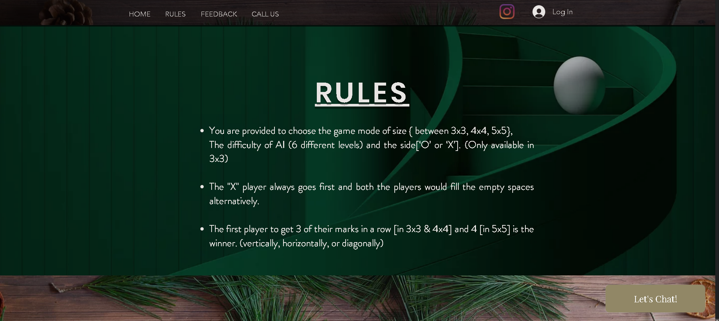
RULES

Slide 12
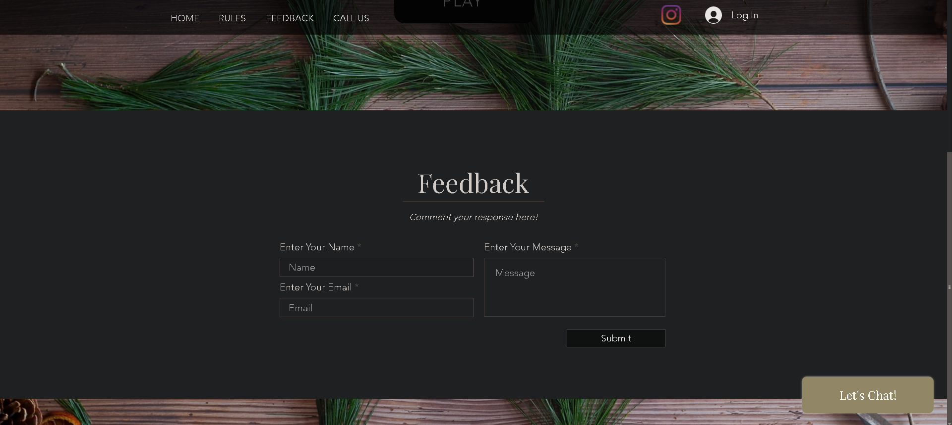
FEEDBACK

Slide 13
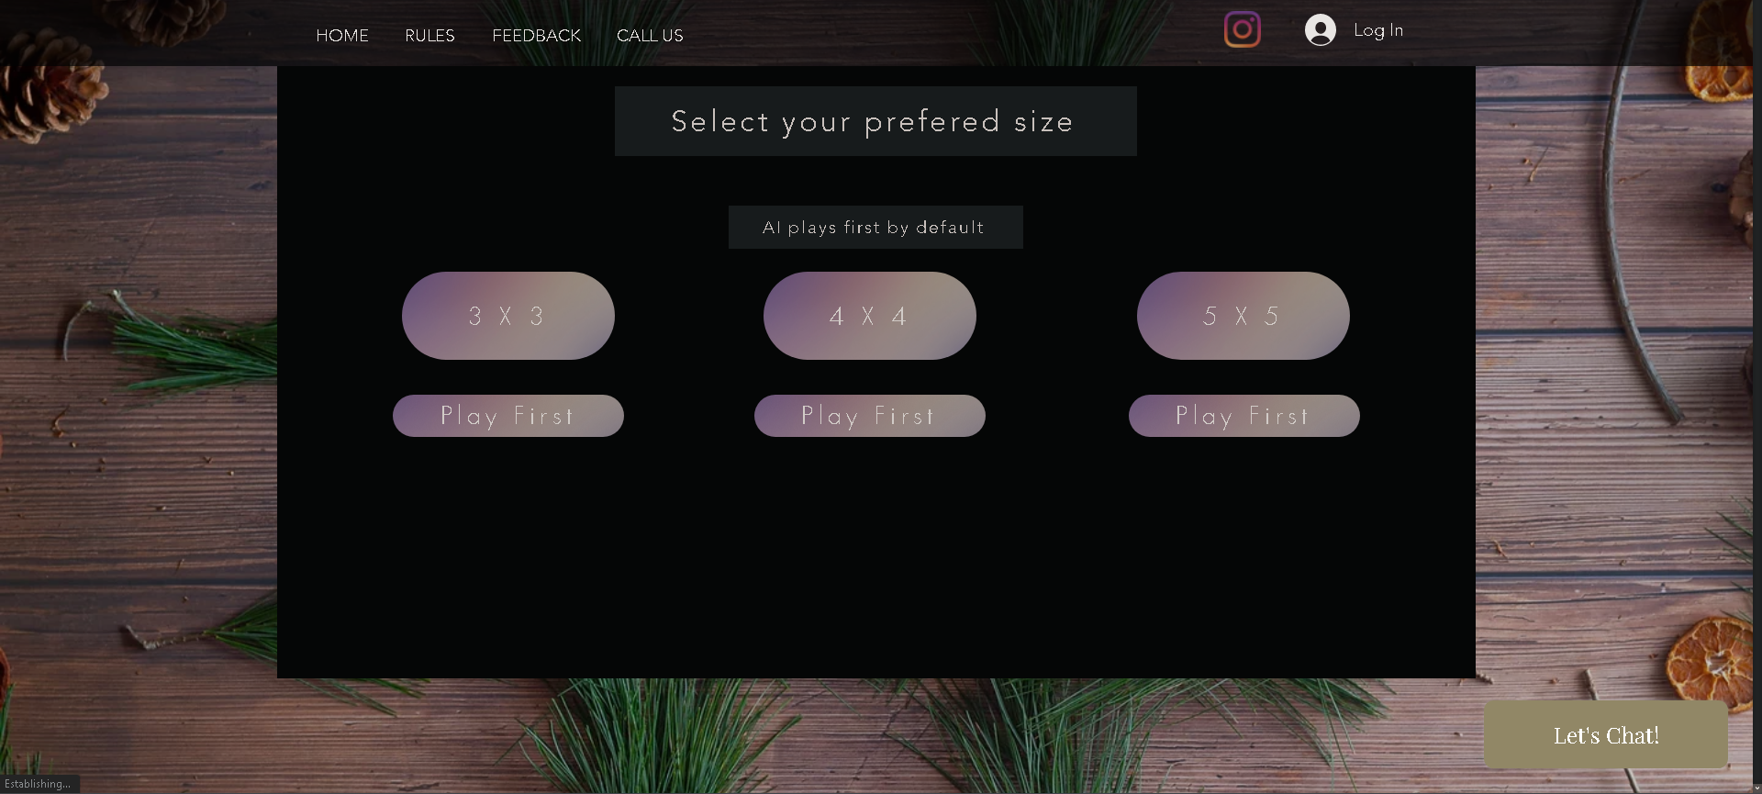
Selecting Game Mode

Slide 14
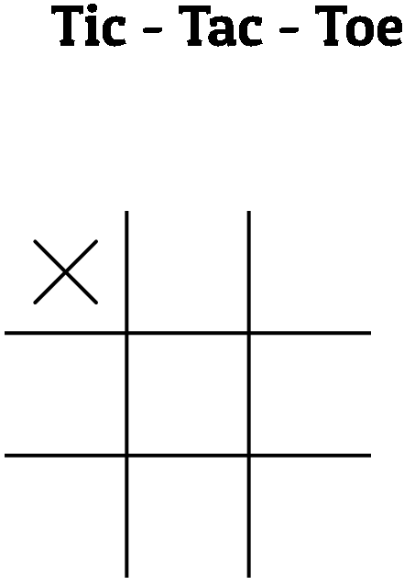
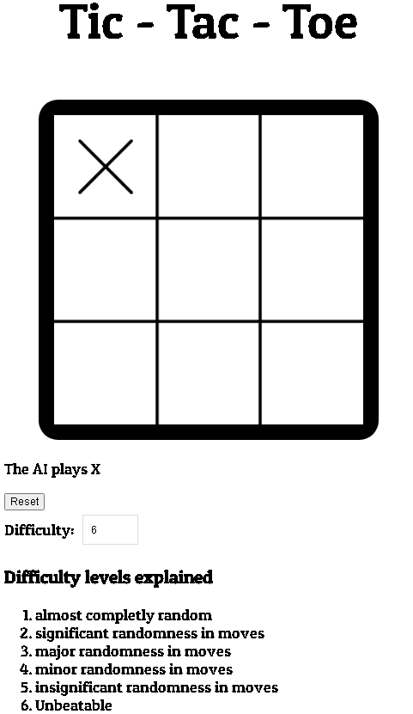
3x3
(With Difficulty)

Slide 15
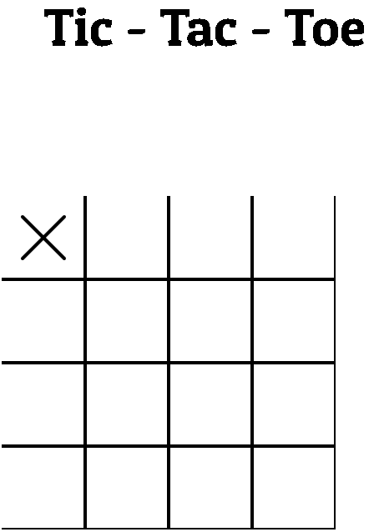
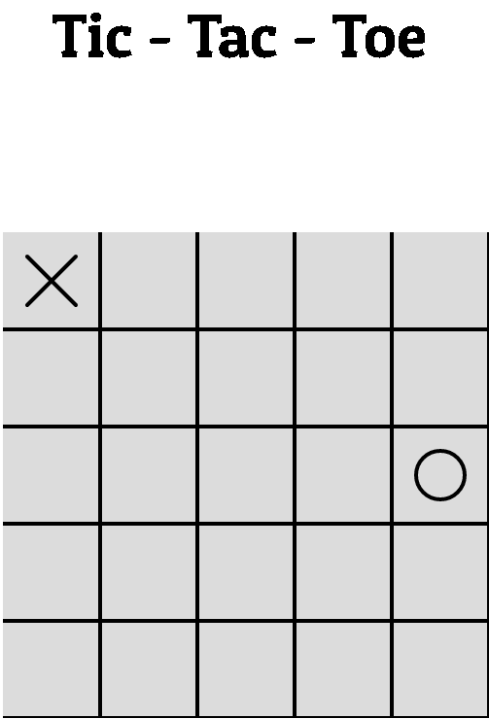
4x4
5x5

Slide 16

TEAM FOR THE PROJECT: Anjali Ma’am (MENTOR) Shreya Singh
Parth Suryavanshi
Surabhi Tambe
Yash Sarang

Slide 17
Thank You.
We Hope you liked our presentation, We hope that you provide us proper feedback to improve our project in any aspect.

